Slide 1
Volvo Truck Analytics
Ioannis Batsios, William Downs, Wahab Ehsan, James Polk, and Christopher Thacker

Slide 2
General Overview
Basic Data Statistics and Analysis
Utility functions (Wahab)
Display Data by Day
Estimator
Outlier Detection
GPS Speed vs. Wheel-Based Speed (Chris)
External Temperature vs. Components (Ioannis)
CPU Load (James)
APU Investigation (Bill)

Slide 3
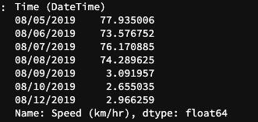

Display Data per Day
Divided data by day using mean.
Function returns average for any attribute/column.
Truck 1 had one week worth data, but Truck 2 had only three days of data.
Truck 1
Truck 2

Slide 4
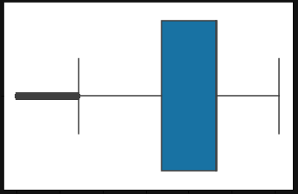
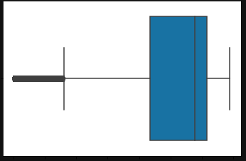
Outlier Detection
Both trucks had several outliers making the data seem scattered.
Made function to show boxplot and then had it remove outliers.
Truck 1
Truck 2

Slide 5
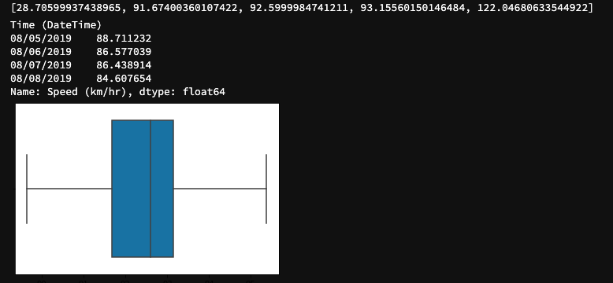
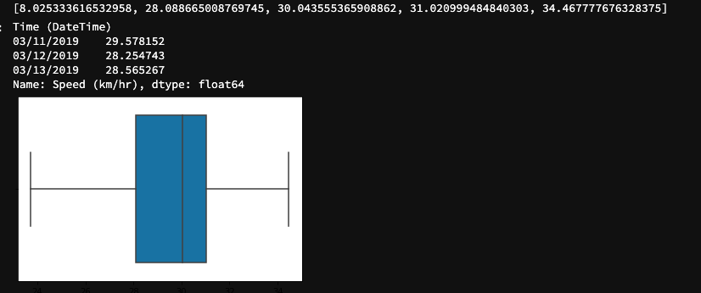
Truck 1
After Outlier Deletion
Min: 28.71
Quartile 1: 91.67
Median: 92.60
Quartile 3: 93.16
Max: 122.05
Truck 1
Before Outlier Deletion
Min: 0.0
Quartile 1: 67.22
Median: 92.60
Quartile 3: 93.15
Max: 122.05
Truck 2
Before Outlier Deletion
Min: 0.0
Quartile 1: 21.71
Median: 28.91
Quartile 3: 31.87
Max: 34.47
Truck 2
After Outlier Deletion
Min: 8.03
Quartile 1: 28.10
Median: 30.04
Quartile 3: 31.02
Max: 34.47

Slide 6
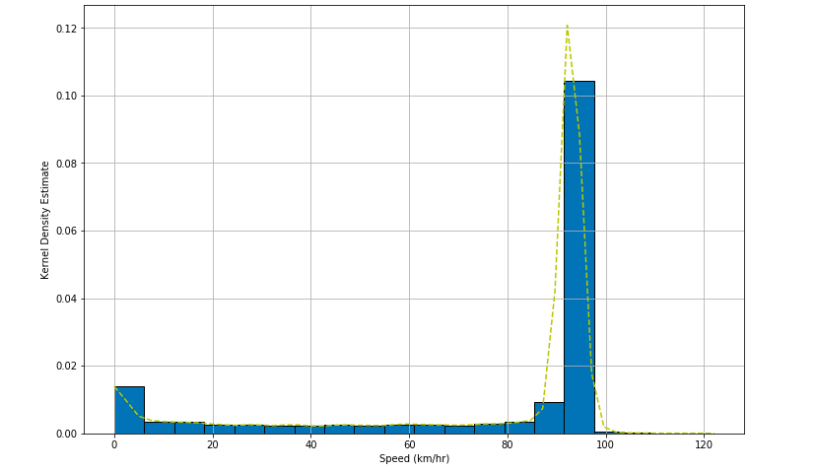
Determining the Estimator
Decided with Kernel Density Estimation (KDE).
Non-parametric estimator
There is no assumption for underlying distribution of variables.
Large Bandwidth since the data is mainly parsed around.

Slide 7
GPS Speed vs. Wheel-Based Speed
Goals
Effectiveness of speed-measuring components.
Consistency between these components.
Basic understanding & exploration of data.
Basic data statistics.
Long-haul or short-haul?
 | Truck 1 |  | Truck 2
 | GPS Speed | Wheel-Based Speed | GPS Speed | Wheel-Based Speed
Mean | 74.55 km/hr (46.32 mph) | 74.83 km/hr (46.50 mph) | 22.69 km/hr (14.10 mph) | 82.13 km/hr (51.04 mph)
Standard Deviation | 31.94 km/hr (19.85 mph) | 31.96 km/hr (19.86 mph) | 12.18 km/hr (7.57 mph) | 44.08 km/hr 27.39 mph

Slide 8
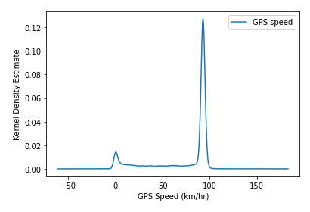
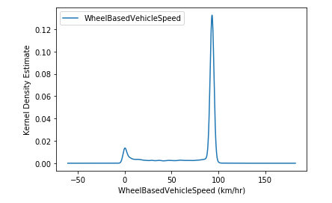
Truck 1: KDE Distributions

Slide 9
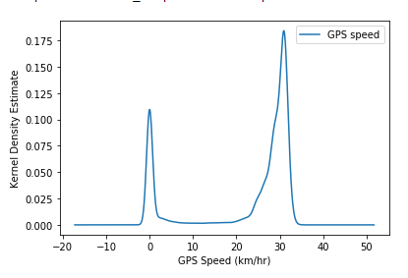
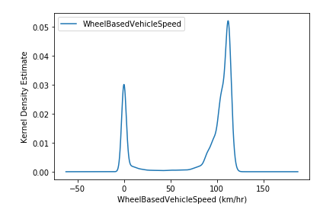
Truck 2: KDE Distributions

Slide 10
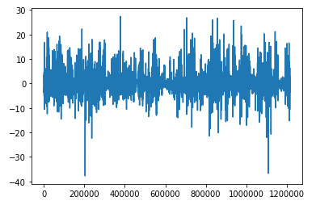
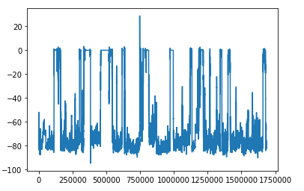
Difference in Speeds within Trucks
Truck 1
Truck 2

Slide 11
Hypothesis Testing
For these two speed components:
A hypothesis test that will be performed is set up as:
H0: There are no differences in speeds between the two components.
Ha: There is a significant difference in speed between the two components.
Since distribution is binomial:
One of the peaks must be isolated to perform a test on.
We can remove the “stop” state peak with outlier detection.
Will be performed in the next phase, as outlier removal was a later addition.

Slide 12
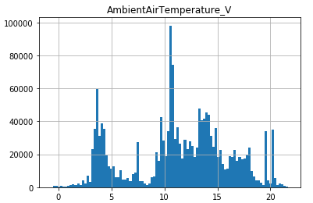
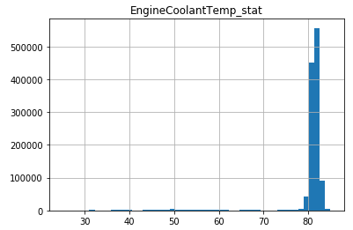
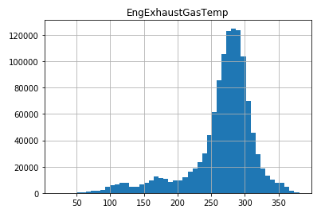
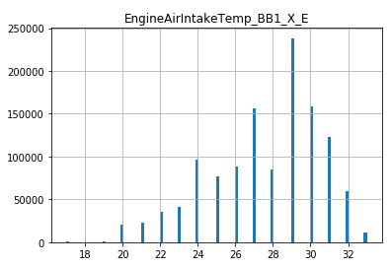
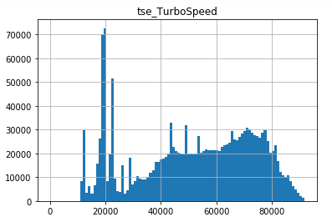
Truck 1 External Temperature vs. Components

Slide 13
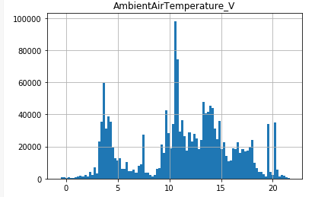
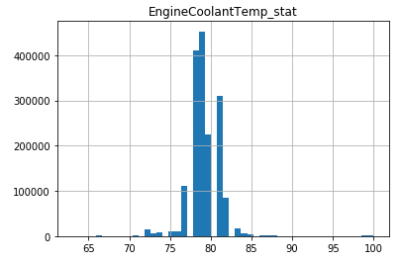
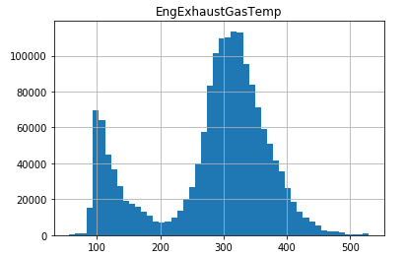
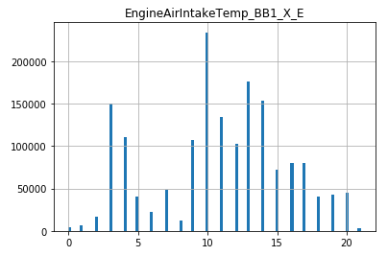
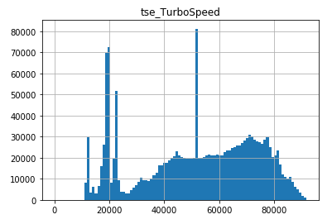
Truck 2 External Temperature vs. Components

Slide 14
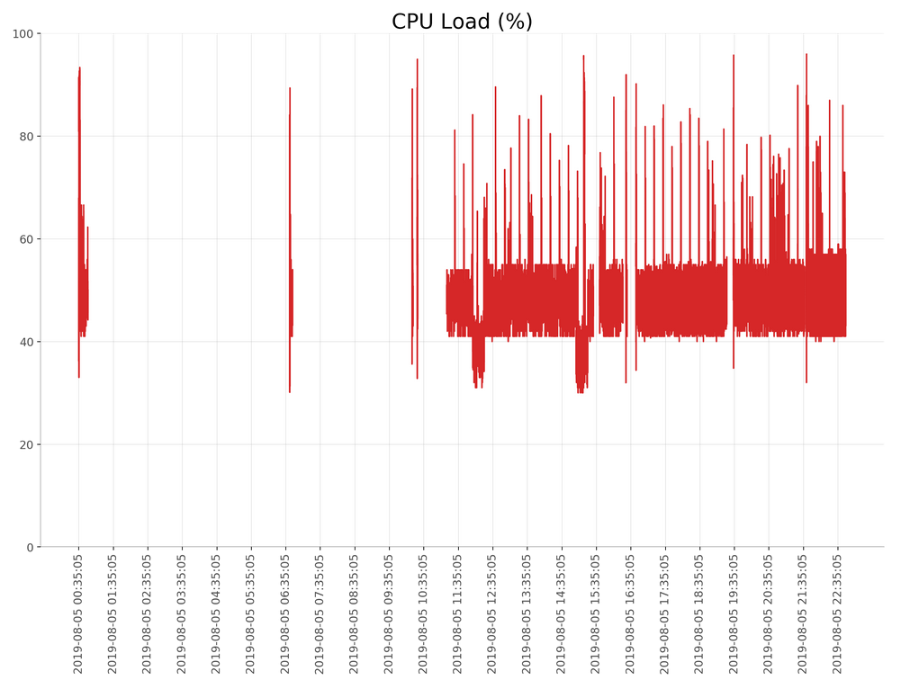
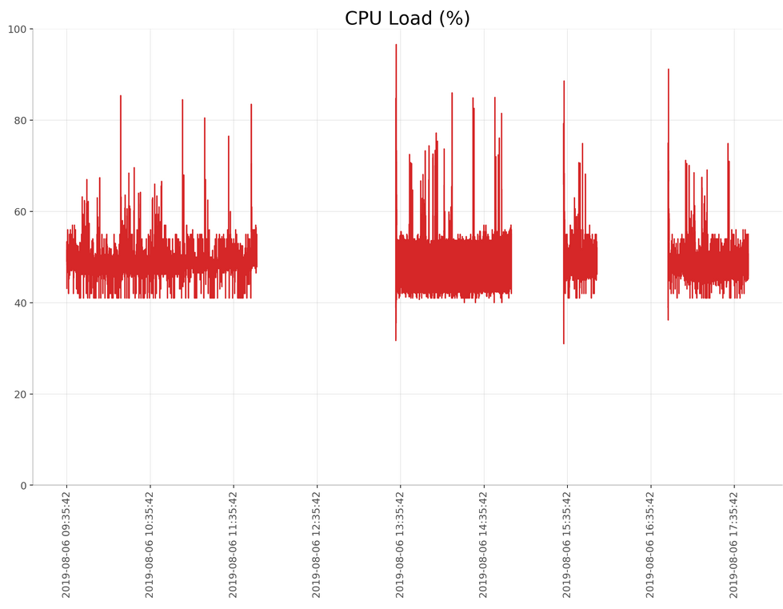
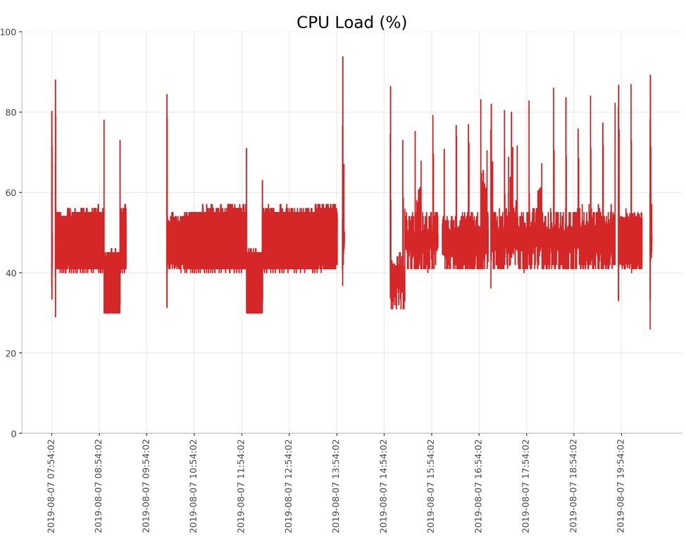
CPU Load
Each day shows significant CPU drop out. Most of the recorded values

Slide 15
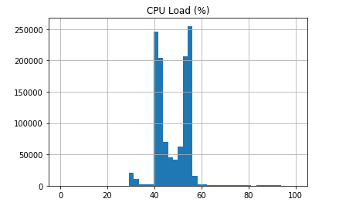
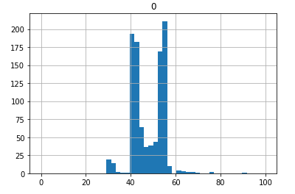
CPU Load
Sample
z-critical value:
1.959963984540054
Sample Mean:
48.356
Confidence interval:
(47.9081645837598, 48.803835416240204)
3 Days
Mean: 47.948982
Mean: 47.759
N = 1000
Diff: 0.189982

Slide 16
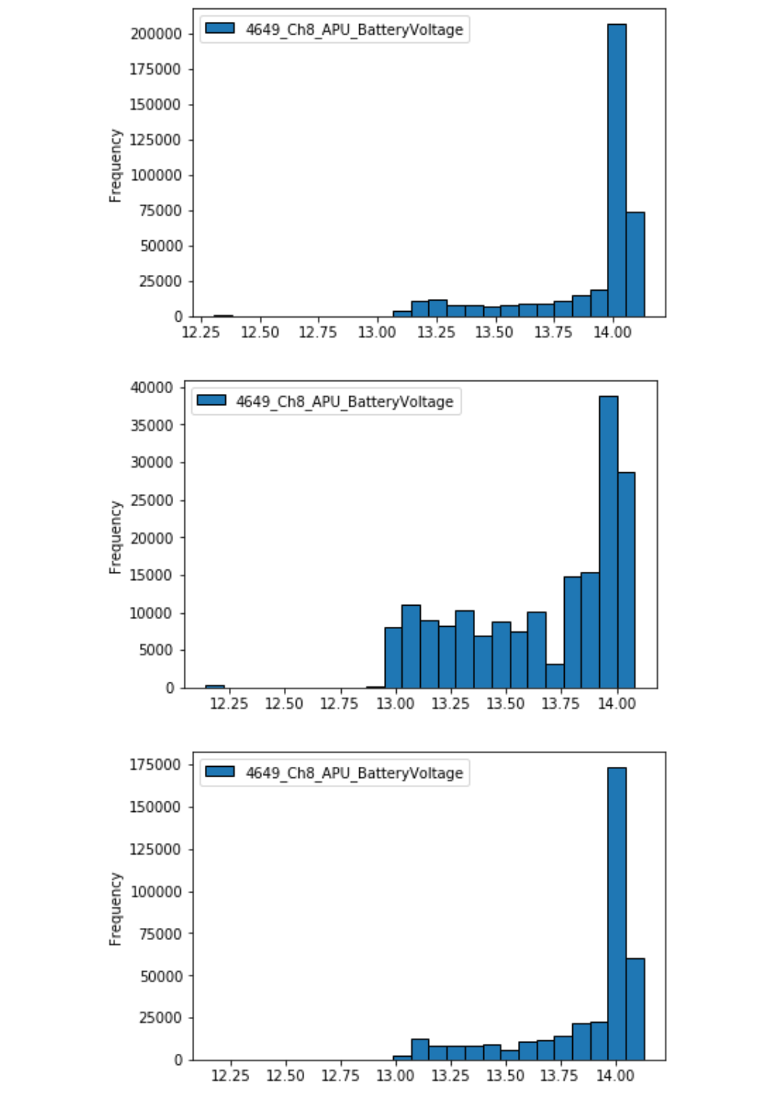
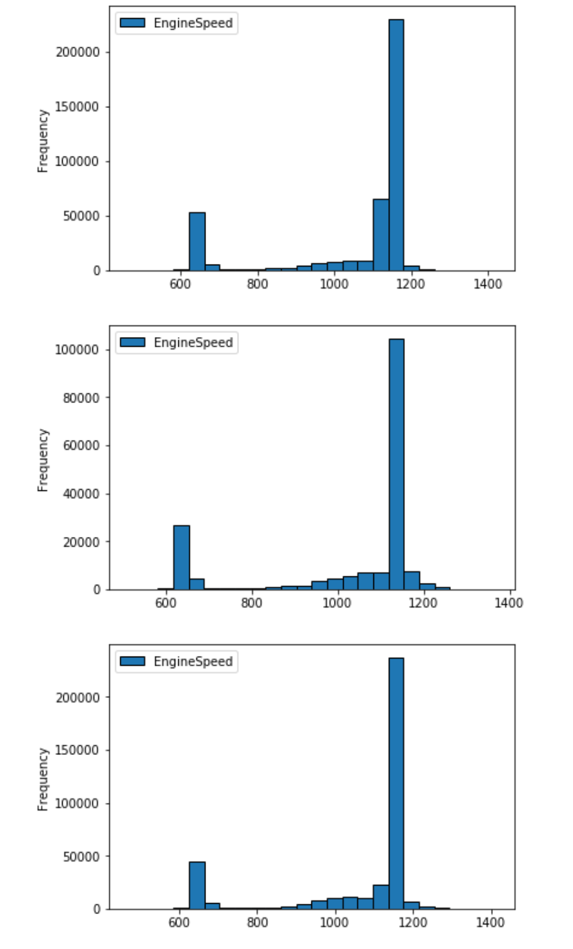
Auxiliary Power Unit
Single day distributions APU voltage and Engine speed
APU is a unit that is utilized to run comfort systems on the truck while the driver is on break. Traditionally all power is derived from the alternator while idling at truck stops.
12 Volt system supplied by 3 deep cells in parallel.

Slide 17
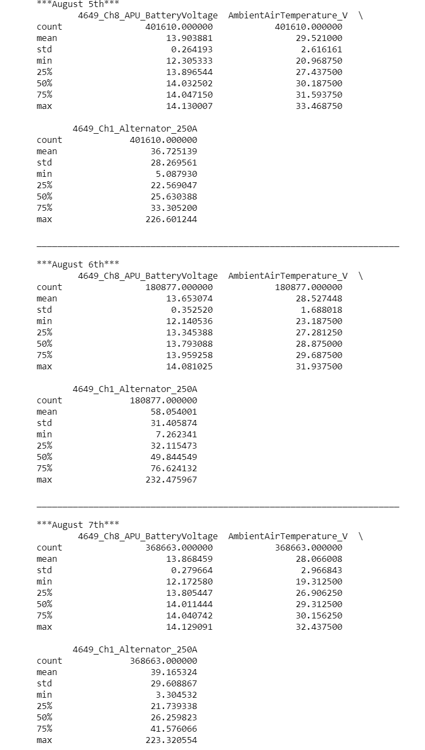
3 day sample describe

Slide 18
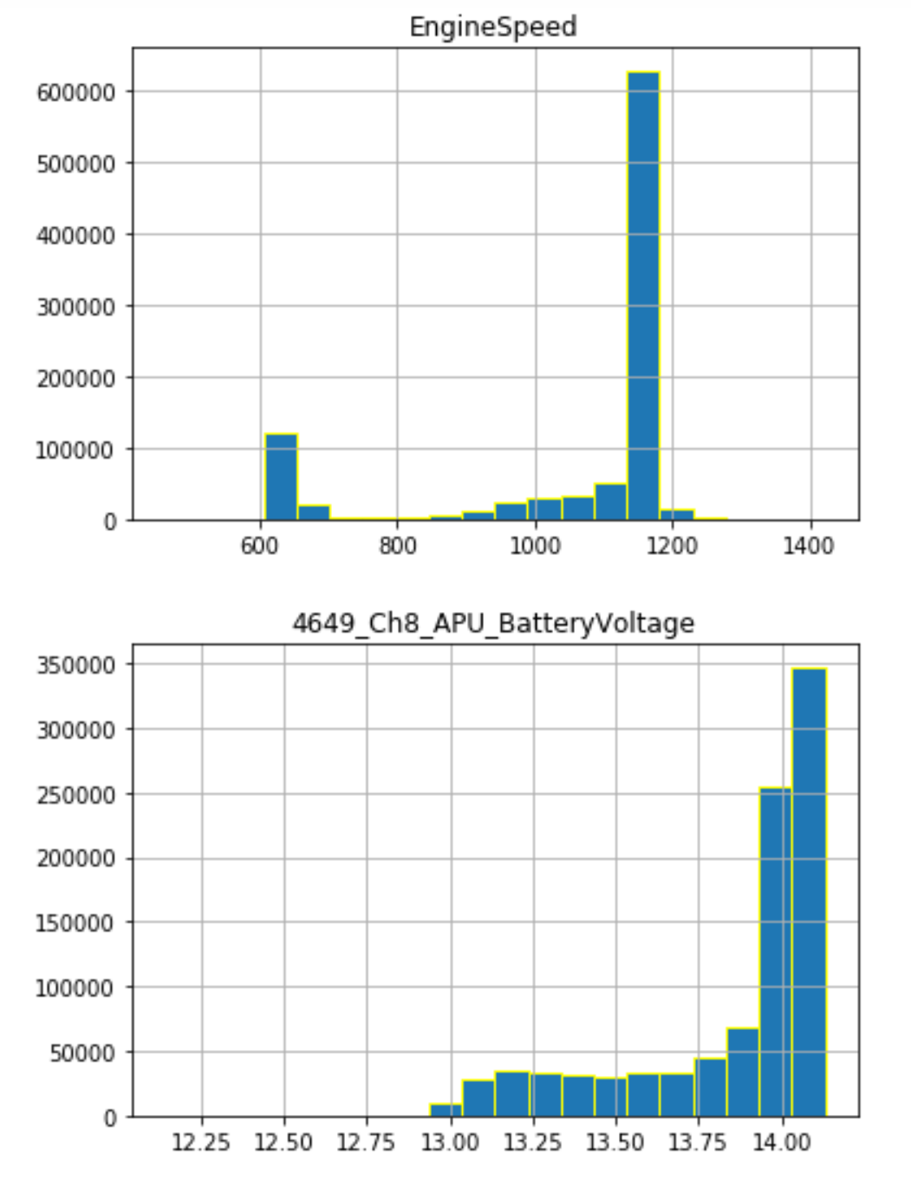
3 day distributions
Vs single day

Slide 19
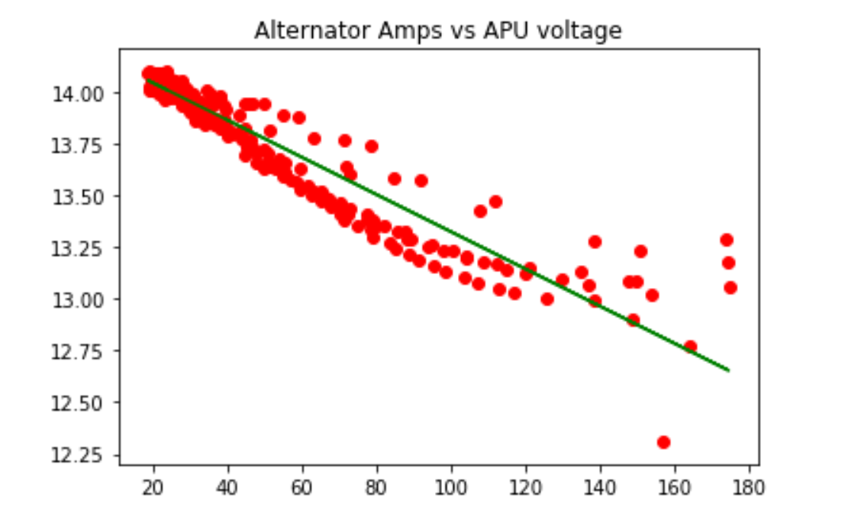
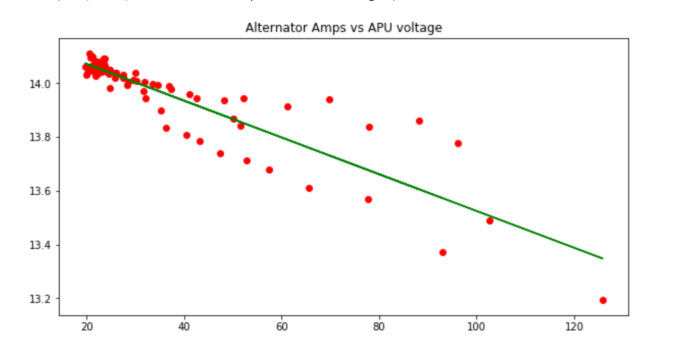
APU: Investigations and ideas!
At any given time when the engine speed is less than idle(off) the apu batteries should be discharging.
Any time the engine speed is greater than idle the batteries should be charging.
As batteries discharge they typically will have a drop in voltage. Lets see a scatter plot of alternator vs battery voltage
3 DAY
1 day

Slide 20
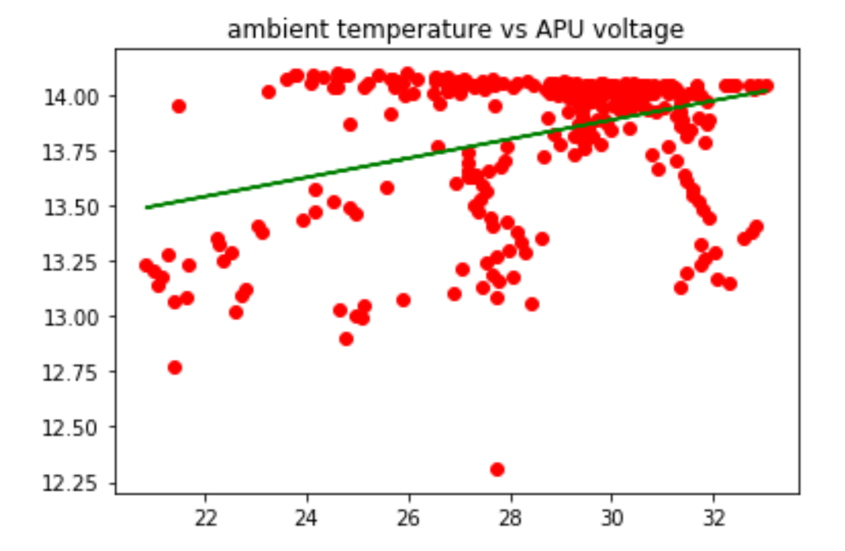
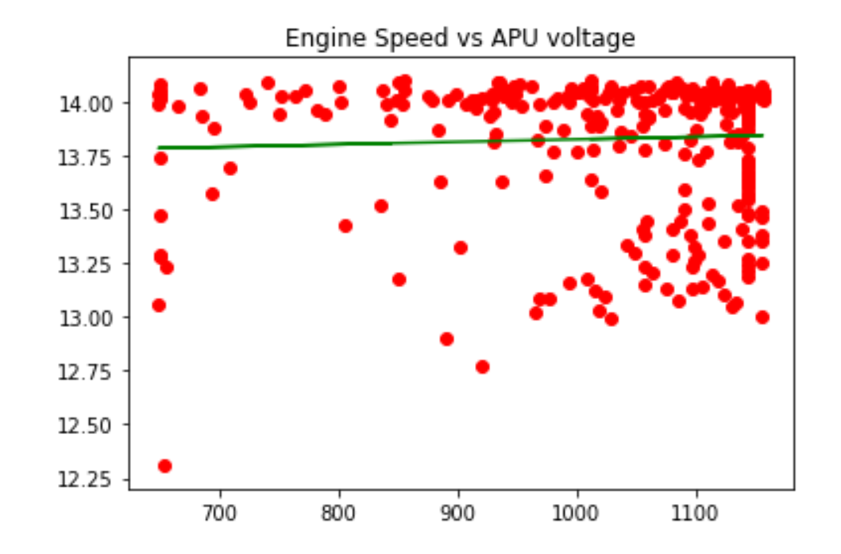
More scatter plots w fitted line

Slide 21
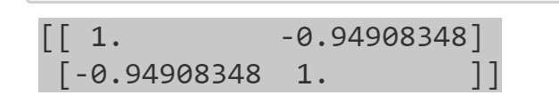
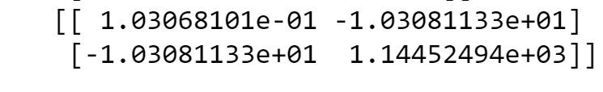
Correlation
APU/Alternator correlation
APU/Alternator Covariance
This shows a strong negative relationship for the APU unit and the alternator

Slide 22
1 Tailed Ttesting and Pvalue
The 3 day sample observation from the APU voltage and average from the apu voltage of 13.82.
The calculated p-value is -6.11e-13 which is well less than .05, so we can reject the null hypothesis indicating that the statistical difference in apu voltage from the average is not caused by chance.

Slide 23
Errors and more
APU: Need a metric that only operates when alternator is off.
APU: A capacity metric would be nice.
GPS and Wheelbase speed outliers.
Other outliers when truck is stopped or when a sensor first starts.

